Slide 1
ROCKBUSTER STEALTH BUSINESS ANALYSIS
Celine Bower

Slide 2
BUSINESS ANALYSIS - AGENDA
What is currently happening within the company?
Where are our best customers located?
What are the best-selling movies and genres?
How can the company grow for the next fiscal year?
What are the biggest takeaways?
What are some recommendations from the finding?

Slide 3
INTRODUCTION
Rockbuster is a film rental company that used to have stores all around the world. Due to the overwhelming online competition, Rockbuster is planning to make a move to online film rentals.
The goal of this presentation is to support business strategists with insights from data analysis and provide recommendations to be successful in the digital market.

Slide 4
COMPANY OVERVIEW
Total film titles: 1000
Total categories/genres: 20
Total customers: 599
Average rental duration: 5 days
Average payment amount: $4.20
Average film replacement cost: $19.98
Average film rental rate amount: $2.98
Total payment amount: $61,312.04

Slide 5
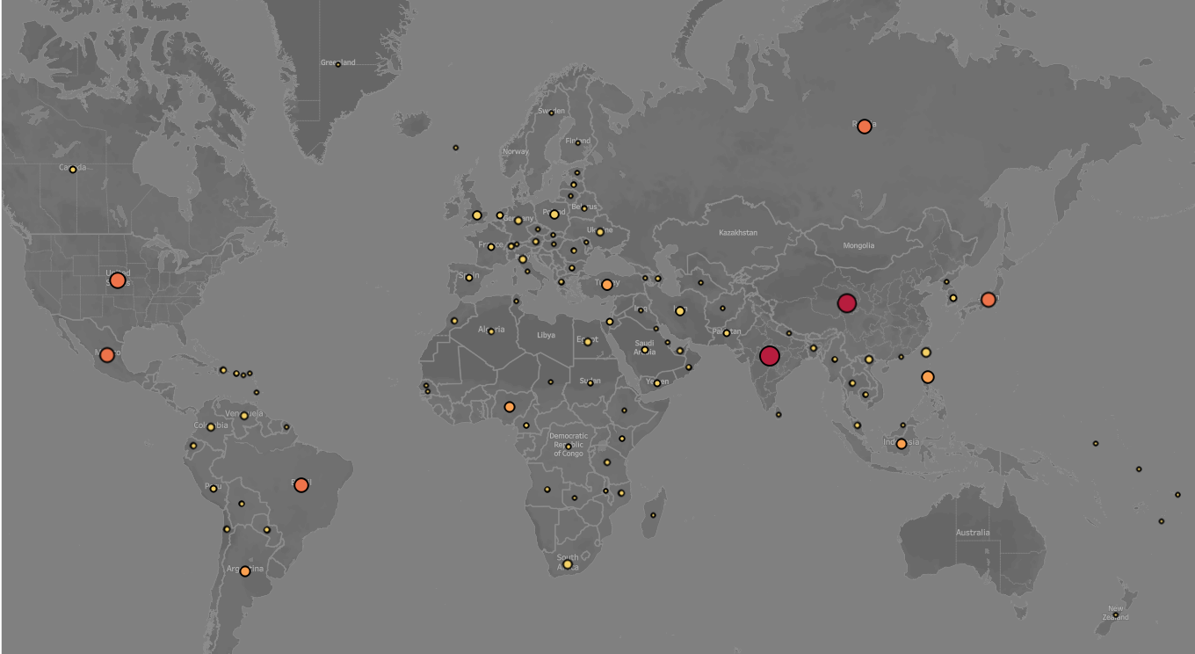

CUSTOMER BASE

Slide 6
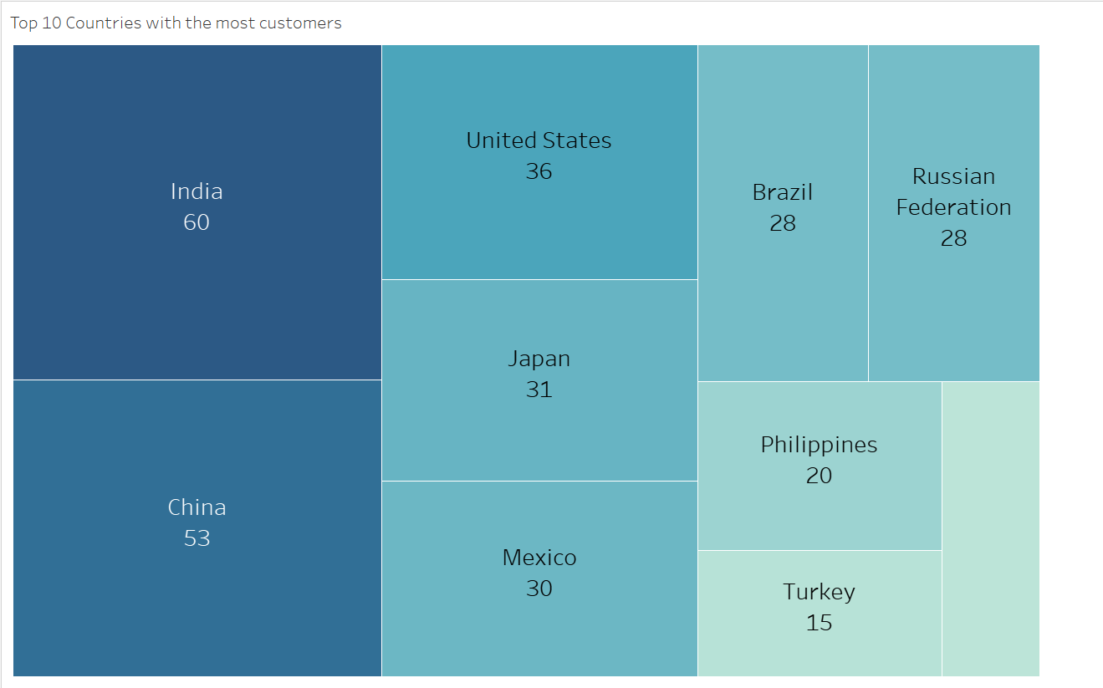
CUSTOMERS BY COUNTRY – TOP 10
Indonesia
14

Slide 7
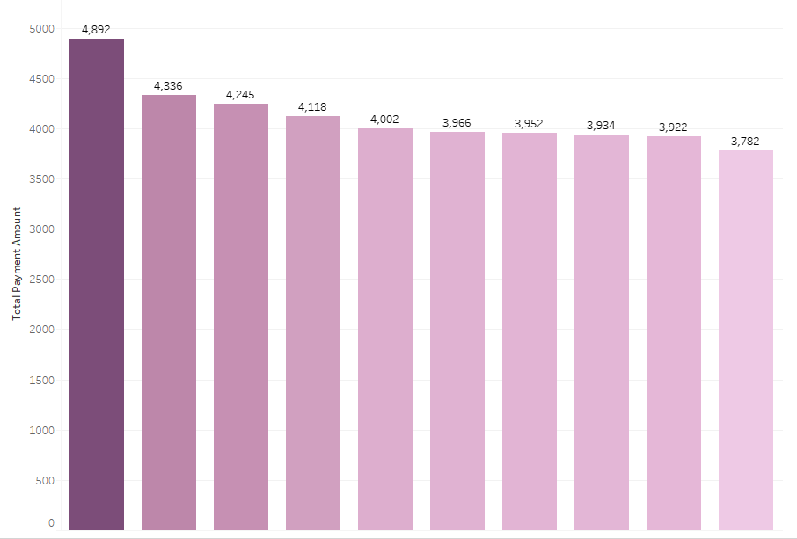
TOP PERFORMING GENRES
Sports
Sci-Fi
Animation
Foreign
Games
Action
Family
Drama
New
Comedy

Slide 8
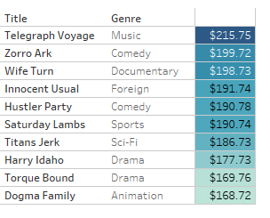
BEST SELLING MOVIES
Payment

Slide 9
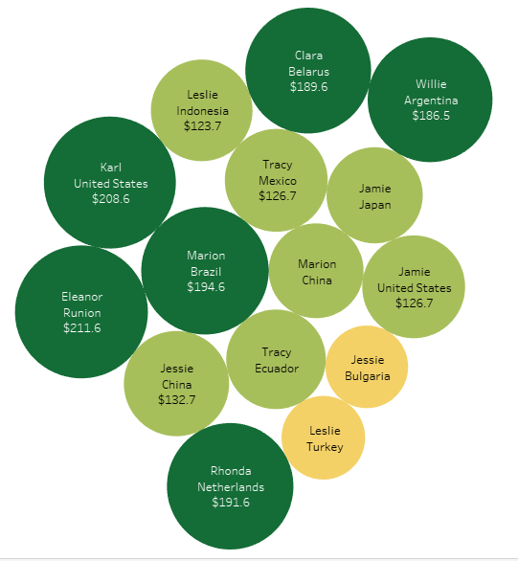


MOST LOYAL CUSTOMERS

Slide 10
WORST PERFORMERS
Category – THRILLER Made $47.89 compared to top performer SPORTS at $4’892.19
Out of 108 countries 41 Countries have only 1 customer each

Slide 11
ROOM FOR GROWTH
Loyal customers keep the business successful
Location
#1 India
Top performing movies
Top performing genres
Sports
Thrillers
Lifetime customers
Worst performers
Sci-Fi
Animation
Telegraph Voyage
Zorro Ark
Wife Turn
#2 China
#3 United States
41 Countries with 1 customer only
1
2
3
4
5

Slide 12

ACTION PLAN
Focus on high-performing Countries
India
China
United States
Customer loyalty program
Incentives on high-value customers
Focus on popular genres
Sports
Sci-Fi
Animation

Slide 13
SUMMARY
Rockbuster’s willingness to tap into the digital market will be challenging when competing against bigger companies. However, knowing where to focus the rollout will be critical and can in the long-run increase sales and establish a digital market.

Slide 14
THANK YOU
Celine Bower

